Slide 1

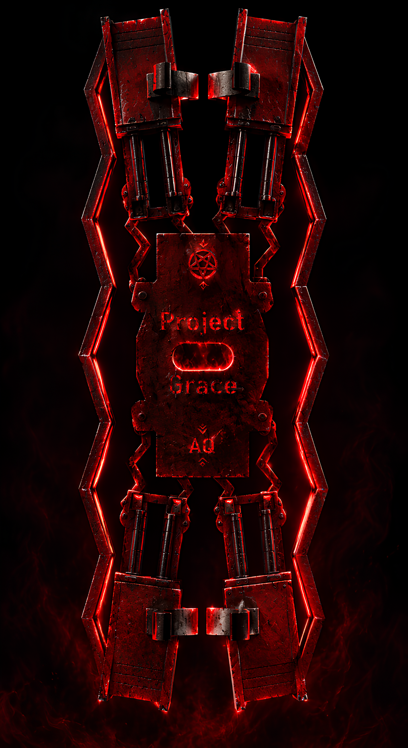
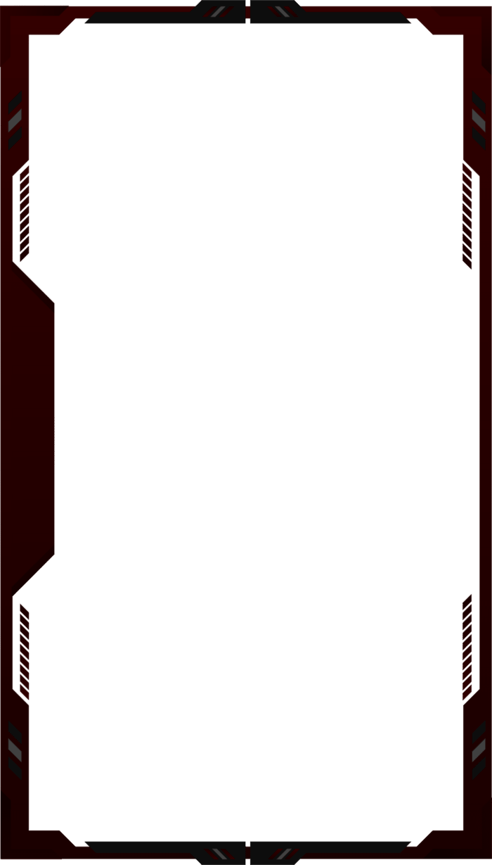
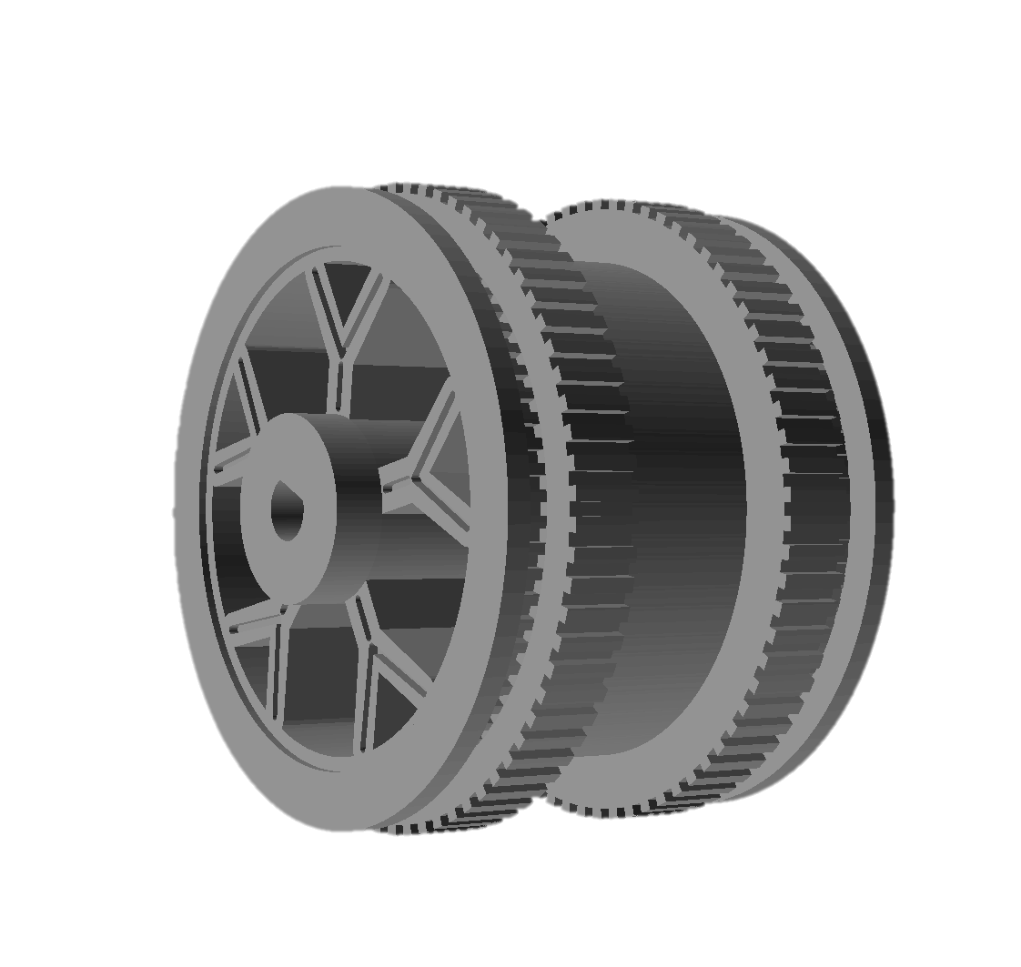
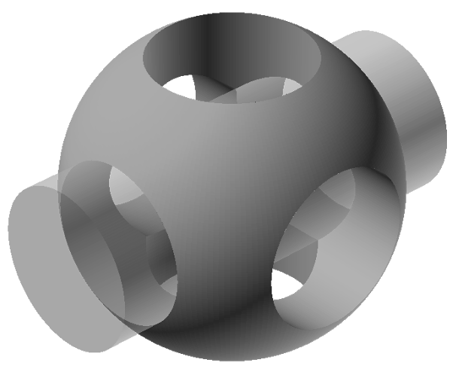




Project Grace
A compliant robot designed to climb a vertical pipe
The Design
Four motor arms extend from a central electronics plate. Paired accordion flexures and outer zig-zag springs allow controlled movement, while motor holders and braces carry loads where stiffness is needed. The frame is designed around a 22 mm pipe and printed in PETG.
Four N20 gearmotors drive four custom twin-tire wheels, providing eight rubber tyre contact bands. The custom wheel bodies retain the supplied rubber tyres and transfer motor torque through a D-shaped shaft bore.
The Powertrain
At the stated 25–45 W system draw, nominal current is approximately 1.7–3.0 A. Ideal runtime from full capacity is about 16 minutes at 25 W or 9 minutes at 45 W. With 80% of capacity treated as usable, the estimates become roughly 13 and 7 minutes. Real runtime will be lower or vary with motor load, voltage sag and conversion losses. Confirm that every powered component is rated for a 4S pack’s 16.8 V maximum.
The controller drives upward until the limit switch activates, pauses for 11 seconds, then descends to ultrasonic distance thresholds of 110 cm and 200 cm, with a 2-second pause at the intermediate point. Distance is sampled every 100 ms; three consecutive sensor failures during descent trigger a stop and fault indication.
The Material
PETG is the baseline because its balance of stiffness and ductility suits the flexures. PLA may be stiffer and less tolerant of repeated high-strain movement; ABS may behave differently and can warp during printing. Substituting material requires testing the spring response, wheel contact and fatigue.
$$GeometryCalculations:$$
$$Wheel−hubspacing:\left[13.2+2\left(15\right)=43.2\text{ mm}\right]$$
$$Armangle$$
$$The roots sit 12mm from thecentreline:$$
$$\left[θ=\cos^{−1}\left(\frac{43.2/2−12}{92}\right)≈{84.0}^{∘}\right]$$
Key Dimensions
Pipe diameter: 22 mm
V7 centre plate height: 108 mm
Arm length: 92 mm
CAD target wheel-hub spacing: 43.2 mm
N20 motor envelope: 45.7 × 15.23 × 11.82 mm
Motor cradle clear length: 47.7 mm
Custom wheel tyre-seat ledge diameter: 31.88 mm
Custom wheel width: 22 mm
D-shaft: 2.85 mm diameter, with CAD print clearance
The custom wheel reuses the N20 motor’s rubber tyres on twin 6.5 mm-wide seats. A continuous rim supports the tyres, while the five-spoke web connects the rim to the hub with less material. The D-shaped bore transfers motor torque, and a 2.5 mm boss offsets the wheel from the frame.

